Slide 1
Website Author Training
Let’s learn about Sitecore

Slide 2
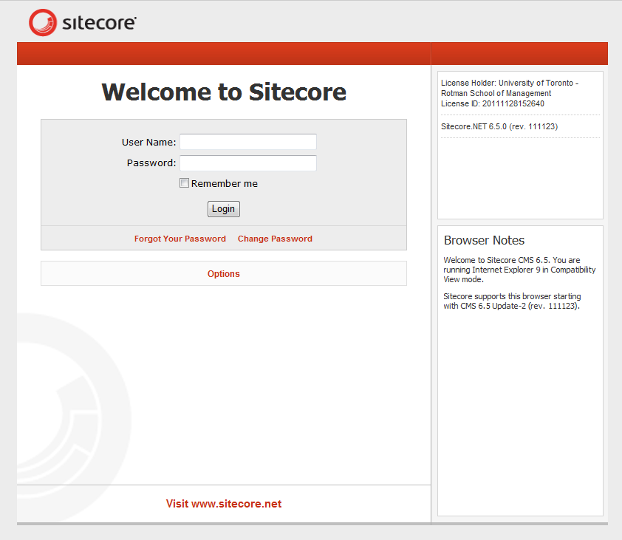
1. Login
Go to: cm-www.rotman.utoronto.ca/sitecore
Username:
-rotman\your computer username
Password:
-your computer password
Note: if you’re using Internet Explorer, Sitecore works best in Compatibility more
Click that!

Slide 3
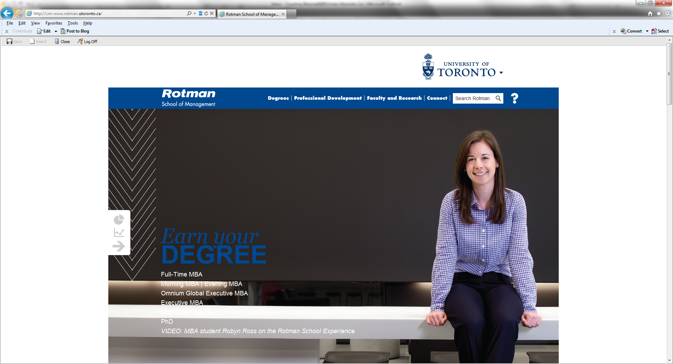
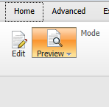
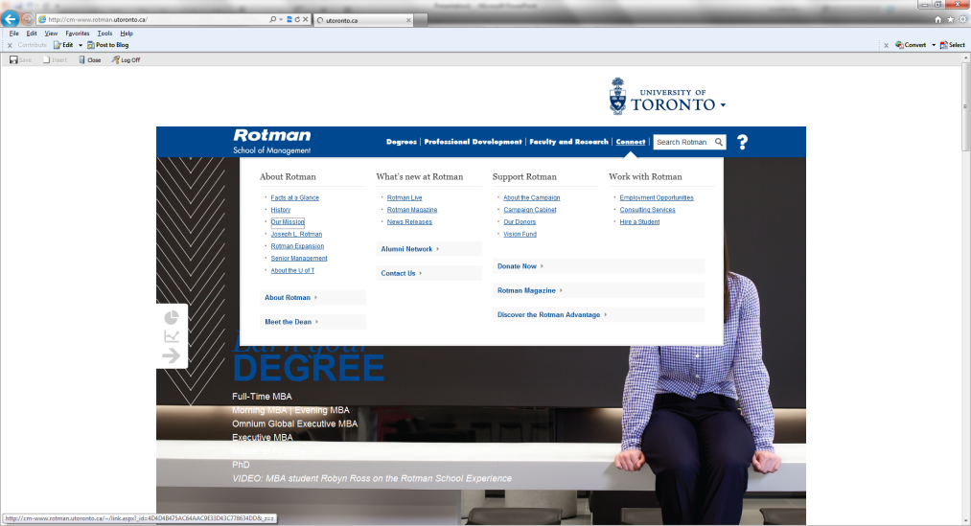
2. Navigate
-to the page you want to edit
Make sure you’re in preview mode
-you get to it under the home menu
Use the expanded nav states

Slide 4
3 (a). Edit
-your content
Move from preview mode to edit mode

Slide 5
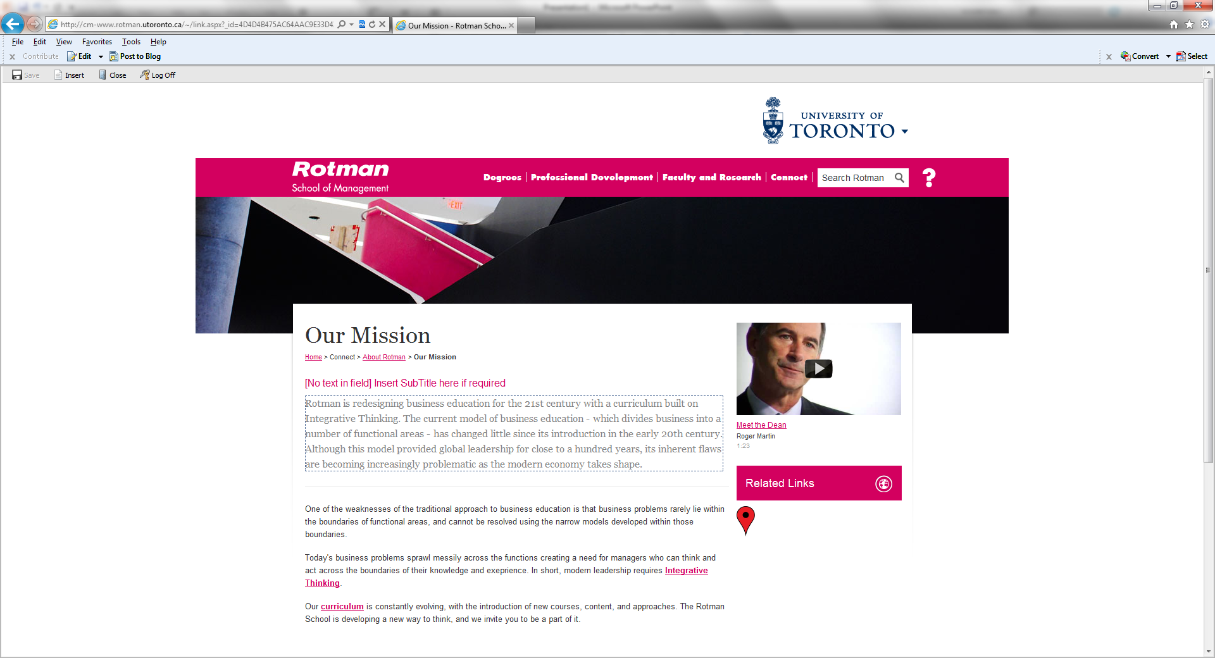
3 (b) Edit
-your content
Anything with a dashed outline is editable!

Slide 6
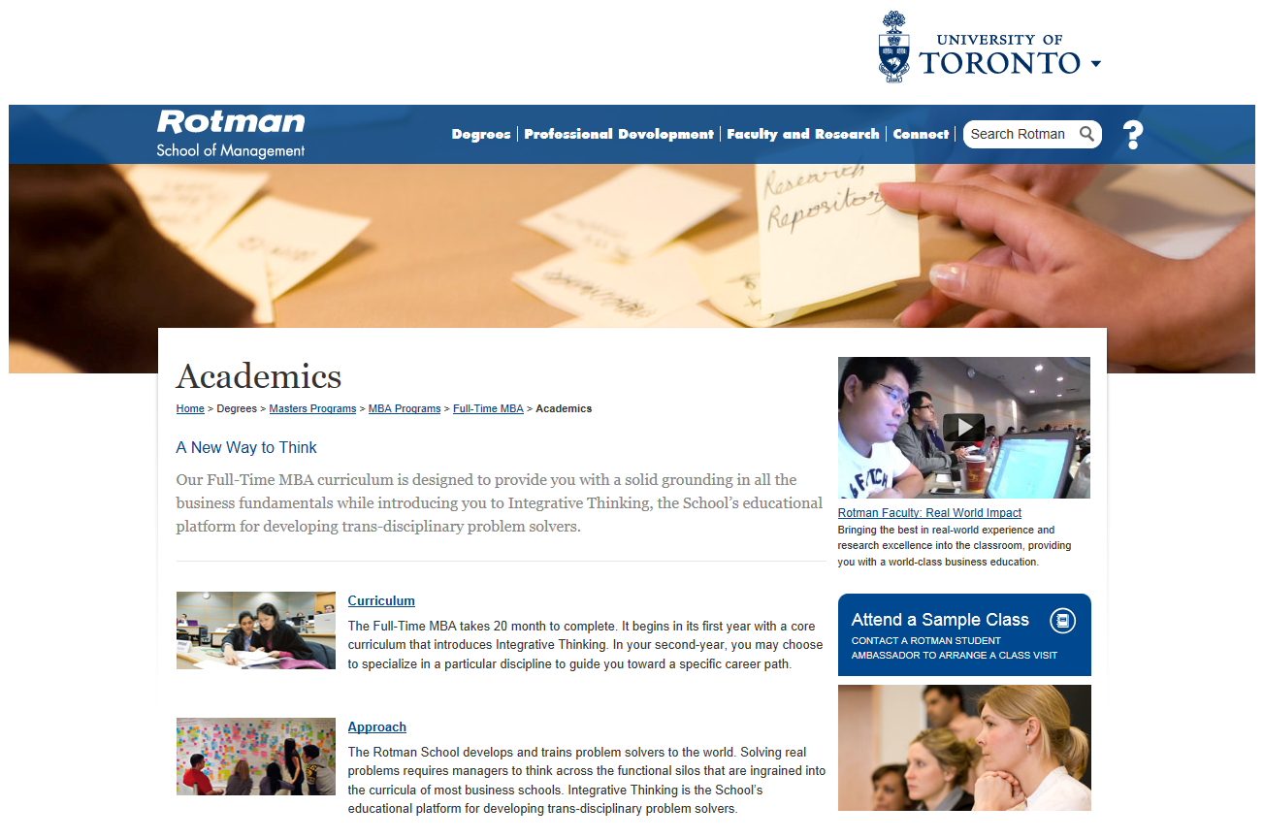
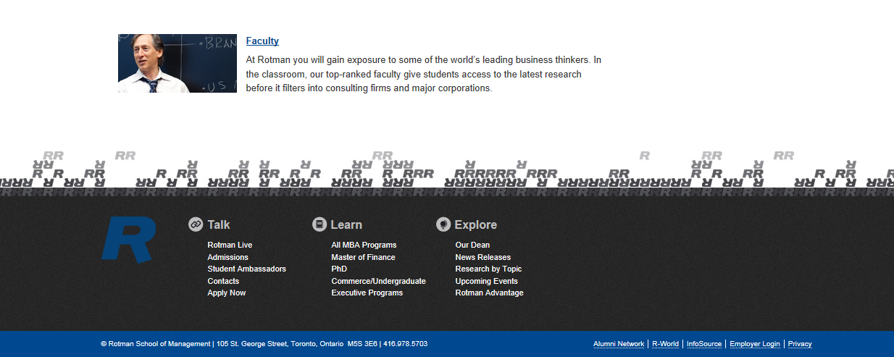
Components of a page
Title
Subtitle
Thumbnail Image
Background Image
Breadcrumb
Teaser Text
Content Area
Right Rail
Note: You can edit any of these elements—some items may be locked. If you find an element locked, let us know and we can make changes for you.

Slide 7
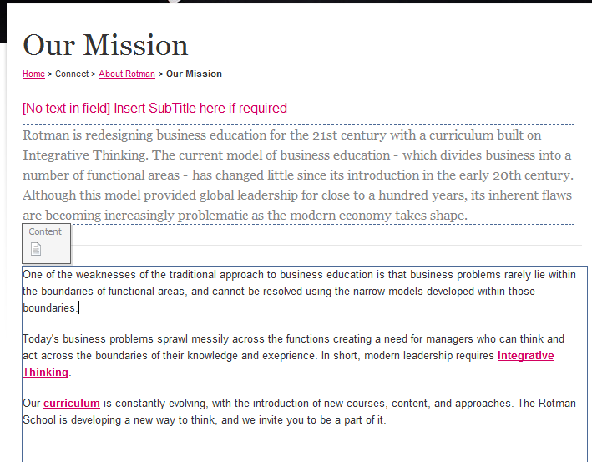
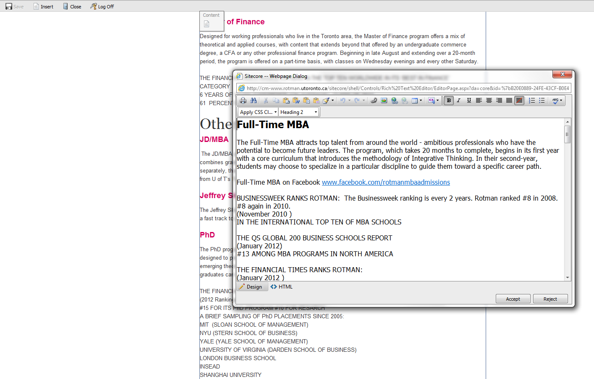
4 (b) Make your changes
-One of two ways
A. By clicking in the box
B. OR opening a content editor window
*This method is great for simple text changes—what you’ll be doing most of the time.
*This method gives you more control of the content and more formatting options—it’s better for when you need to make a lot of changes.

Slide 8
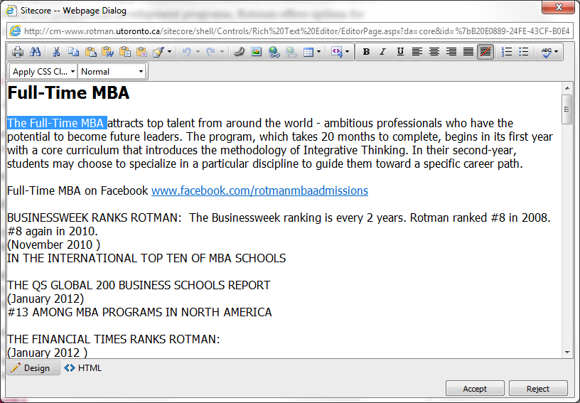
Content editor window
Add links
-internal
-external
Simple formatting
Add an image

Slide 9
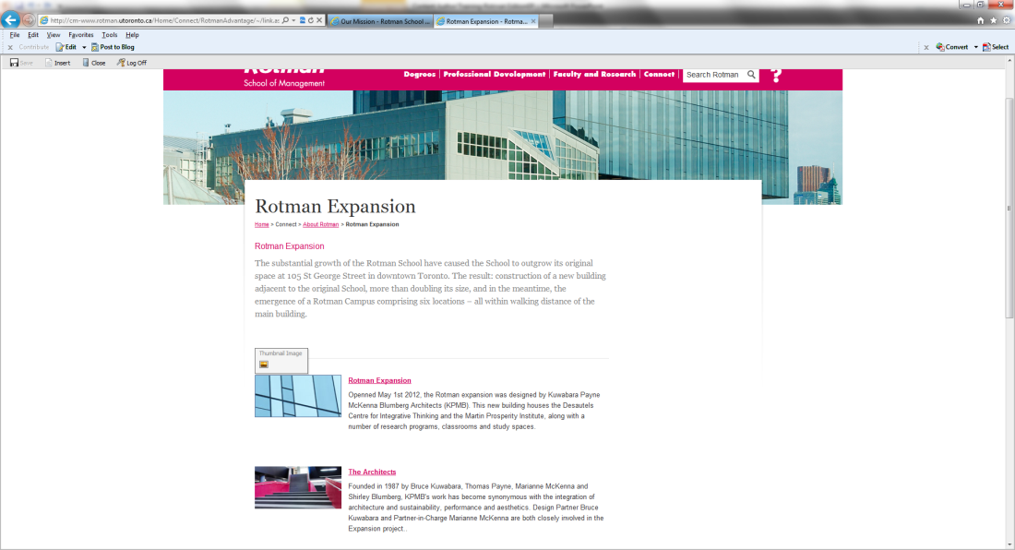
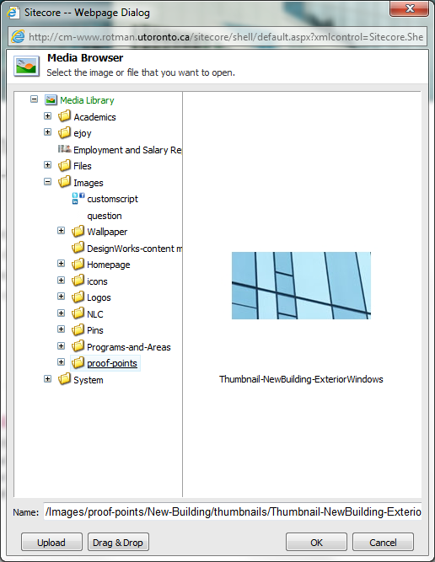
Editing Images & the media library
Programs & Areas is for users to store images that are only for their pages
Proof Points contains images that are open for anyone to use
Click the image
*Images and files are stored in the media library. The media library is organized by your Program or Area and by Proof Points.
Choose an alternate from the media library
Hit OK!

Slide 10
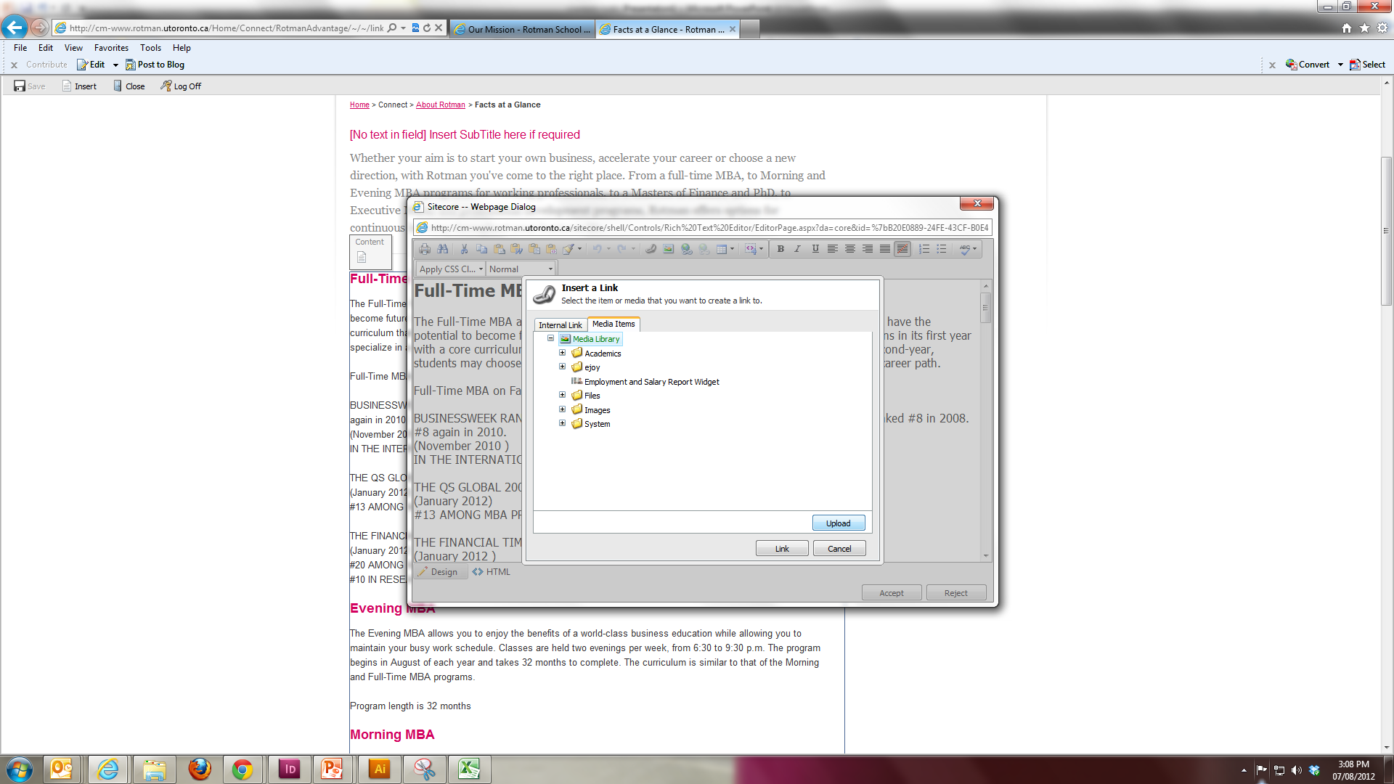
Adding files
*You can add links to word documents or pdfs – you just need to store the file in the media library first!

Slide 11
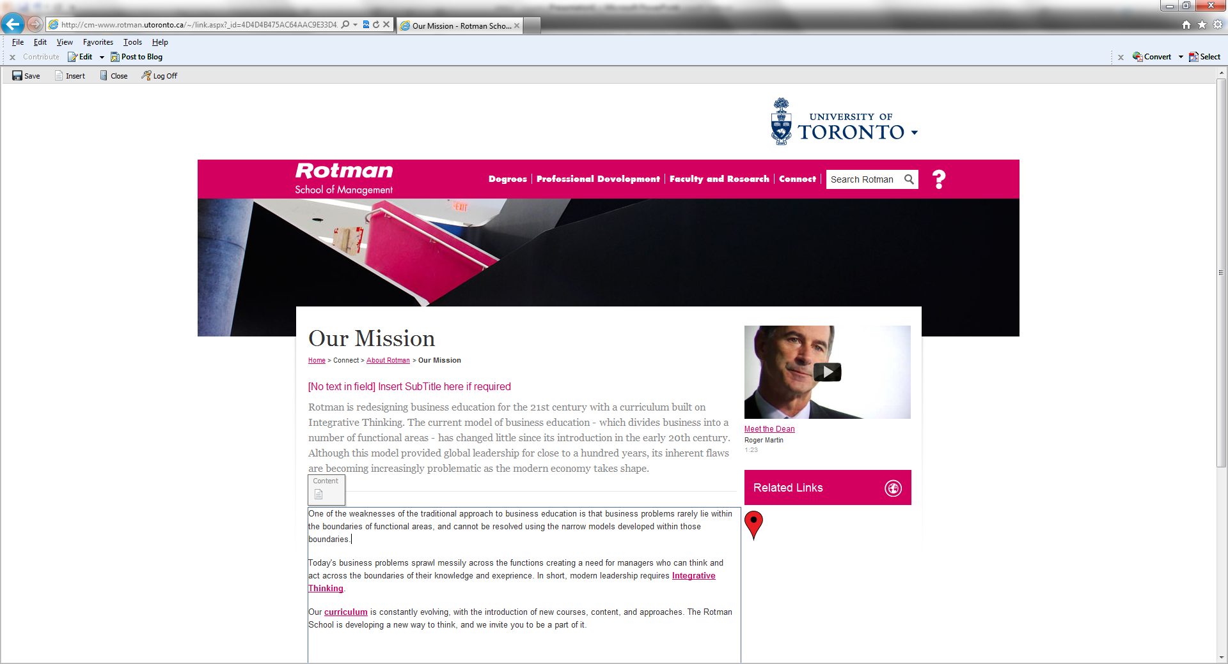
5. Save
-to submit your changes
Once you save your changes are entered into the approval process…

Slide 12
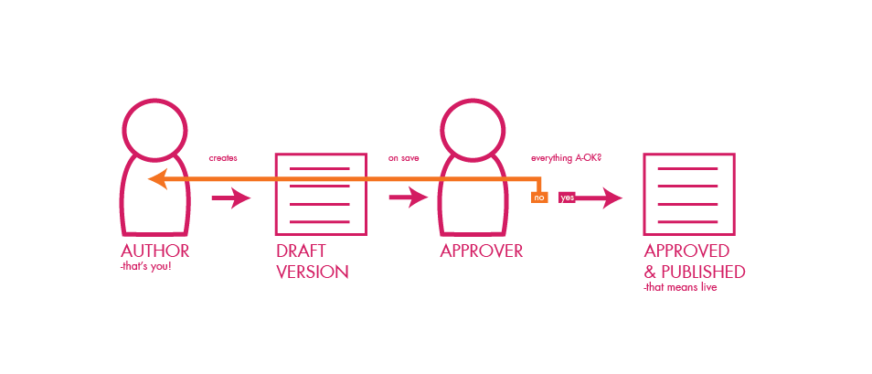
The approval process
*Publishing cycle – Approved pages are published 3 times a day:
9am, 1pm & 4pm
That means you won’t see any changes until after this cycle has run.

Slide 13
6. Unlock -final step when you’ve completed your changes

Slide 14
Demonstration time!
We’ll go through the entire process!
Logging in
Editing content
Adding images & files to the media library
Saving our changes

Slide 15
Next Steps & Resources
Logins
Resources
Superusers: Pym Buitenhuis, David Yang, Stephen Watt, Courtney Brownell, Chris Gusen, Amy Fong, Jenn Hildebrandt, Jen Neil-Smith, Sally Smith, Eugene Grichko, Catherine Riddell, Eric Joy
Marketing Team: Pym Buitenhuis, David Yang, Stephen Watt & Courtney Brownell
Academic Areas
David Yang will continue to set up your events, course information is stored within individual program areas

