Slide 1
Content Author Training
Let’s learn about Sitecore

Slide 2
Agenda
2. Getting to know Sitecore
3. Content editing
4. Managing media
5. Putting it together

Slide 3
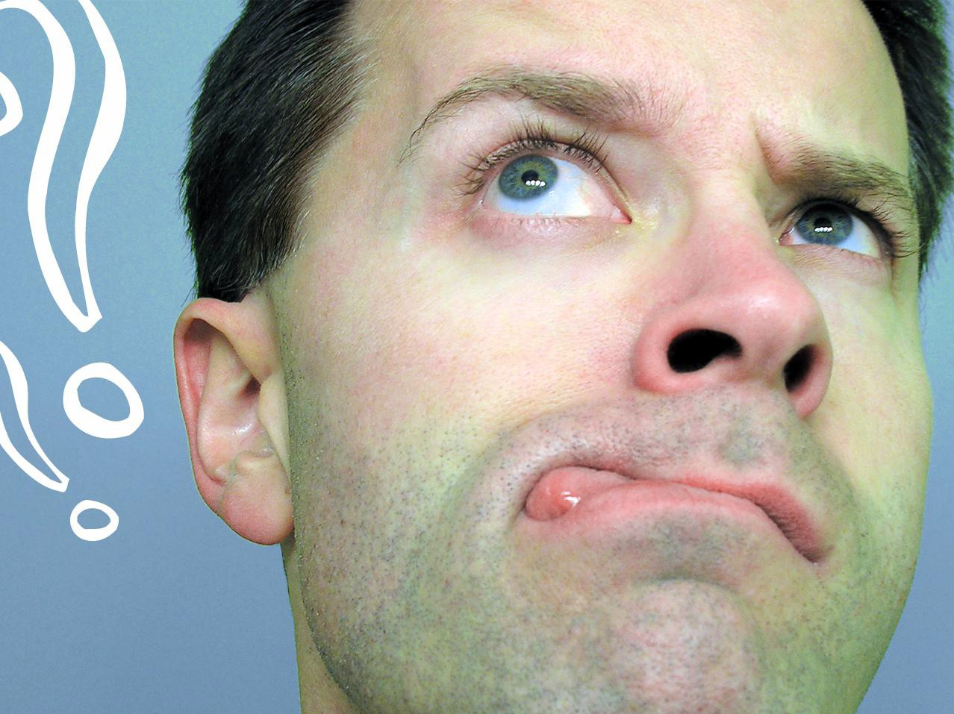
Getting to know Sitecore

Slide 4
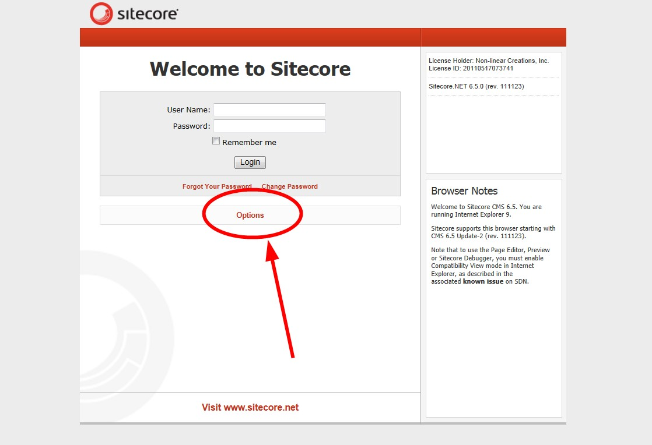
Login Modes
Clicking “Options” shows you the various editing interfaces available
Note: if you’re using Internet Explorer, Sitecore works best in Compatibility more
Click that!

Slide 5
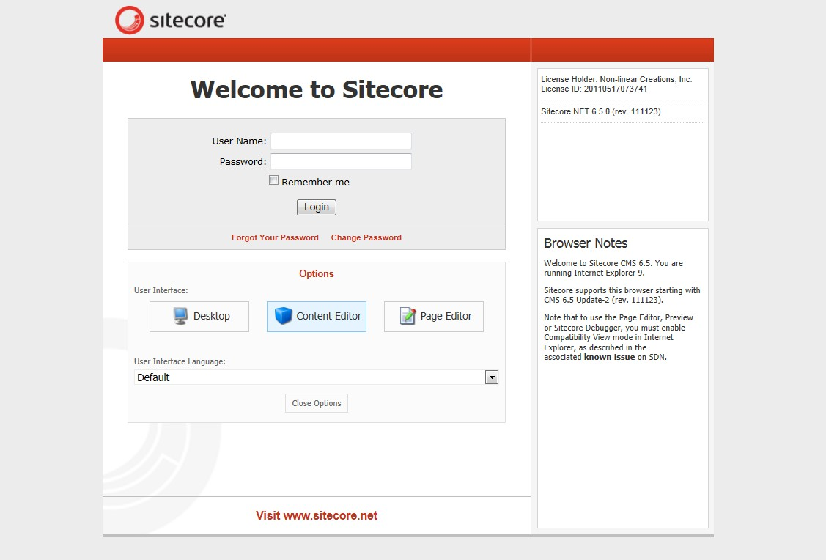
Desktop:
Takes you to the standard Sitecore “desktop” screen
Content Editor:
Can be used to edit/create/delete any item in the content tree
Page Editor:
Only allows the you to edit/create/delete items that can be browsed to.
Note: You can change the mode at any time

Slide 6
For this training session:
We will start by logging into desktop mode, using that to launch the content editor. We’ll use that to edit some items and the page editor to edit others.

Slide 7
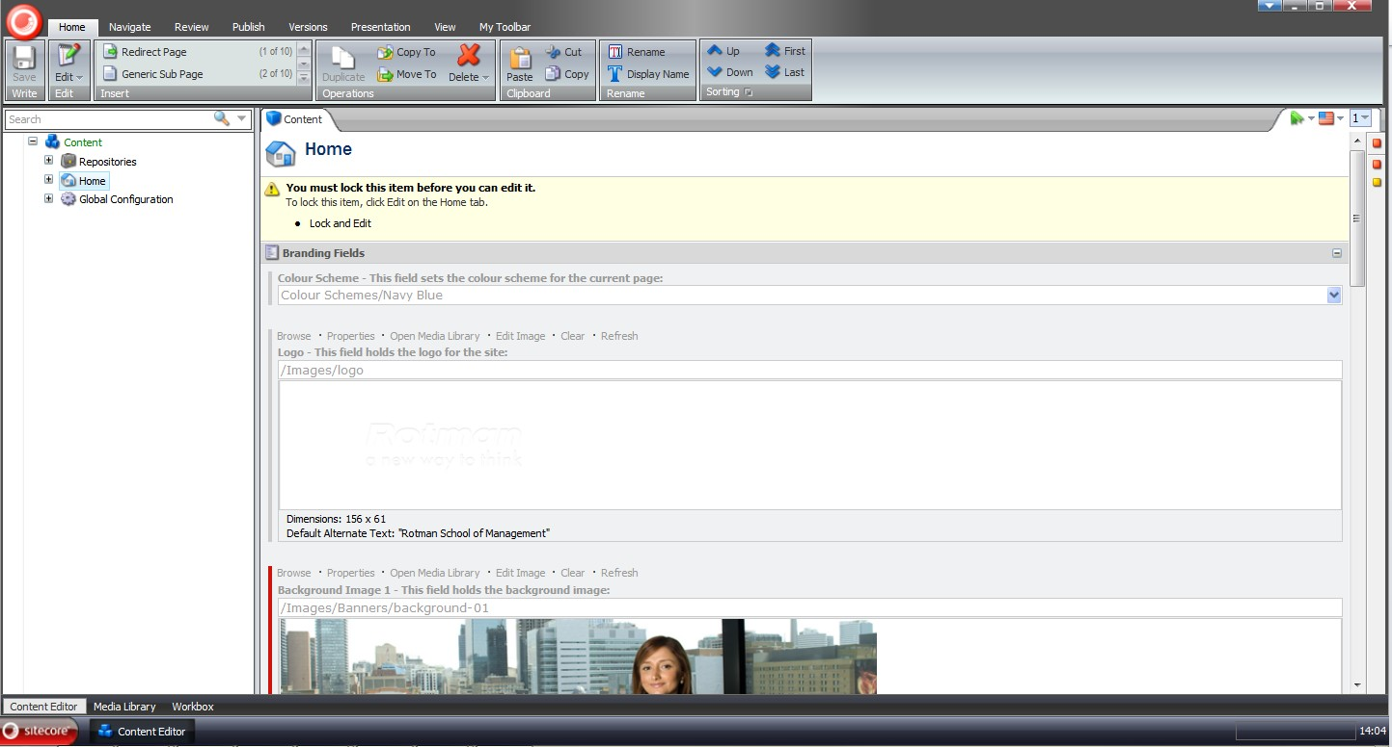
Sitecore Interface
The Ribbon
Content Tree

Slide 8
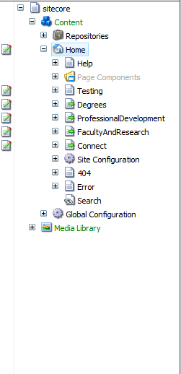
The Content Tree
Repositories is where our widgets are stored
The pages are nested under the “Home” icon and are grouped by the main navigation labels. They are organized as per the content inventory document

Slide 9
Content Editing

Slide 10
Page Editor
Page Editor mode allows you to work, essentially, in a WYSIWYG mode

Slide 11
To open a page in the Page Editor mode, navigate to it in the content tree then click it…

Slide 12
... select "Publish" from the ribbon and click on "Page Editor"

Slide 13
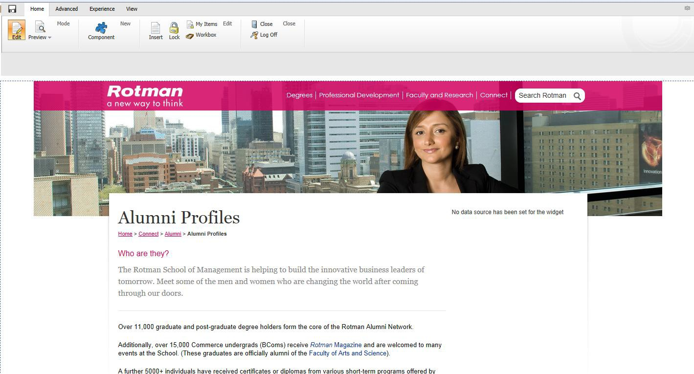
This opens a WYSIWYG version of the page so you can edit the content as it is seen by site visitors.
Note: The right rail will always appear in the Page Editor mode. However, if nothing is added to this space, the content will fill the full width of the page in preview and published modes.

Slide 14
Demonstration Time!
Editing content fields in Page Editor
Adding and removing widgets in the right rail
Previewing your changes
Saving your changes

Slide 15
Content Editor
The content editor mode displays the various fields associated with each page. It is not a WYSIWYG interface but it is useful, especially for quick edits

Slide 16
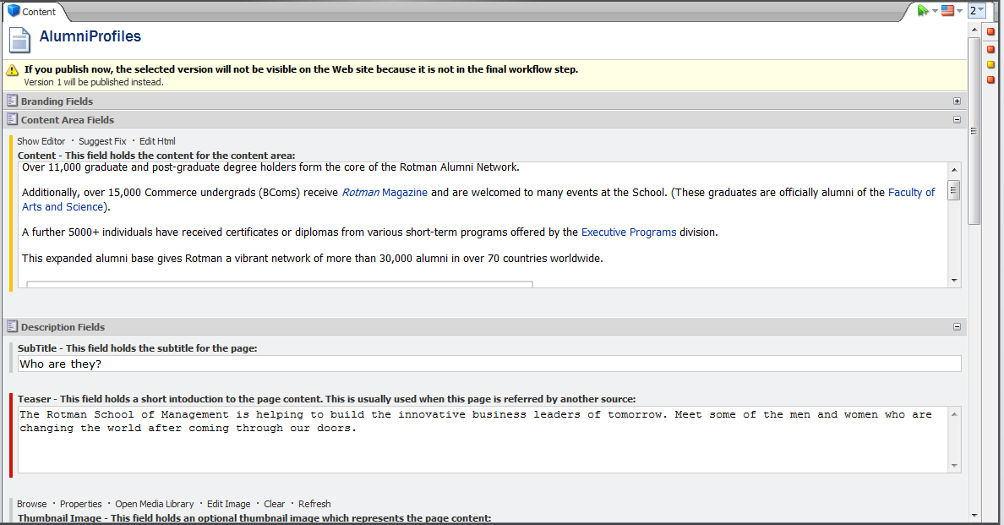
You can also edit the main page content directly from the Content Editor mode. Clicking “Show Editor” on the field you want to change launches a rich text editor.
Note: widgets must be added and removed from Page Editor mode

Slide 17
Demonstration Time!
Editing content fields in Content Editor
Previewing your changes
Saving your changes

Slide 18
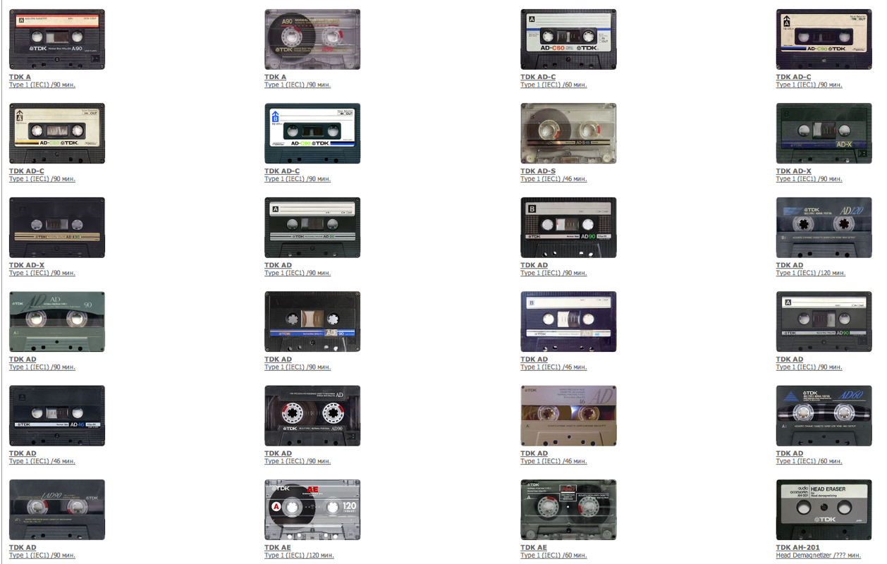
Managing Media

Slide 19
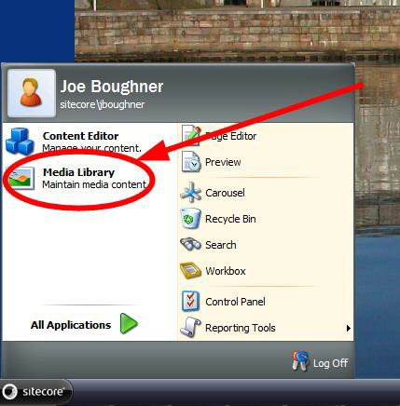
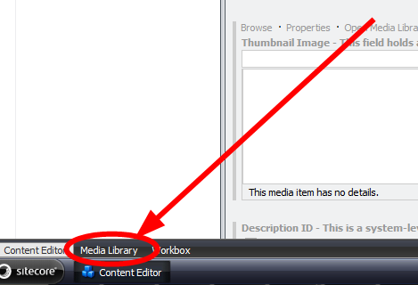
Media Library
Accessible from the Desktop or the Content Editor mode

Slide 20
Files stores any documents like a pdf or word document
Images is where all the .jpegs, .gifs & .pngs you see on the website are stored. Organized by:
Wallpaper – common wallpaper files, open to all
Programs & Areas – storage space orgainized by division
Proof Points – common images, available to everyone, holds images of the Rotman building, the Dean, Classrooms etc.
Note: Each area is organized by image size. Refer to the web style guide for more information on images on the website

Slide 21
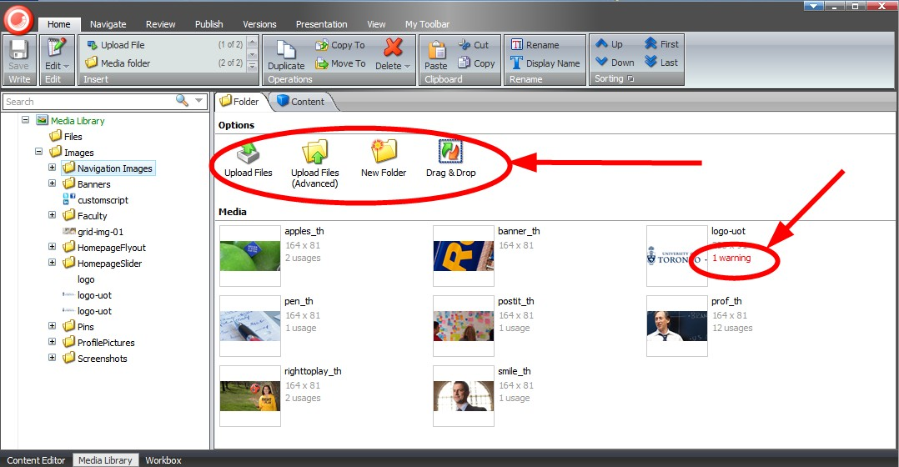
When you click on a folder in the Media Library content tree, you’ll see various upload options and a preview of the media in that folder.
Note: If you see a warning on an image, mouseover to view a description of the warning. Most errors are caused by missing alt tags

Slide 22
Demonstration Time!
Uploading media
Deleting media
Locking and editing media
Unlocking media
Reviewing your locked items

Slide 23
Putting it Together

Slide 24
Creating Pages
From Content Editor mode, you can either use the “Insert” area in the Home tab of the ribbon OR you can right click on the parent page to which you would like to create a child

Slide 25
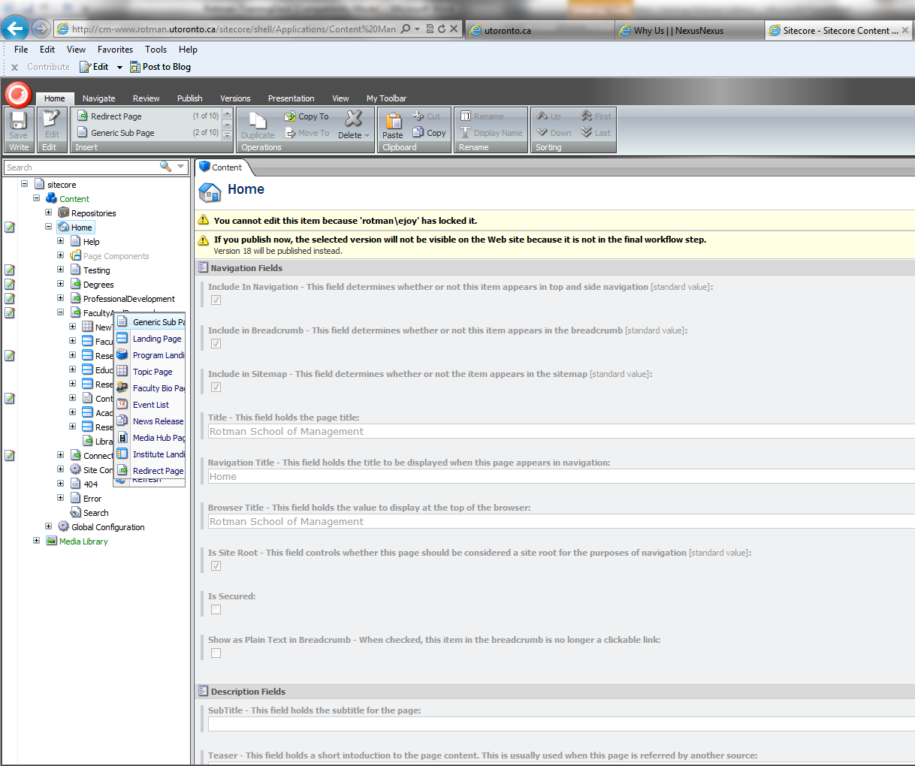
Just Click!
Right Click > Insert

Slide 26
Page Types
Generic sub page
Landing page
Program landing page
Topic page
Faculty bio
Event
News release list
News release page
Media hub
Institute landing
Institute sub page
Redirect page
Note: some of these pages you may not need to use, we’ll go over the underlined ones

Slide 27
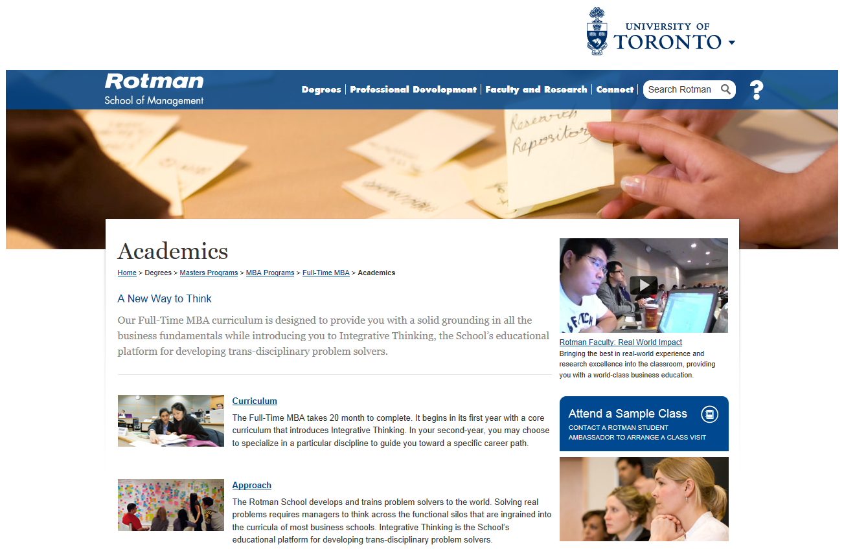
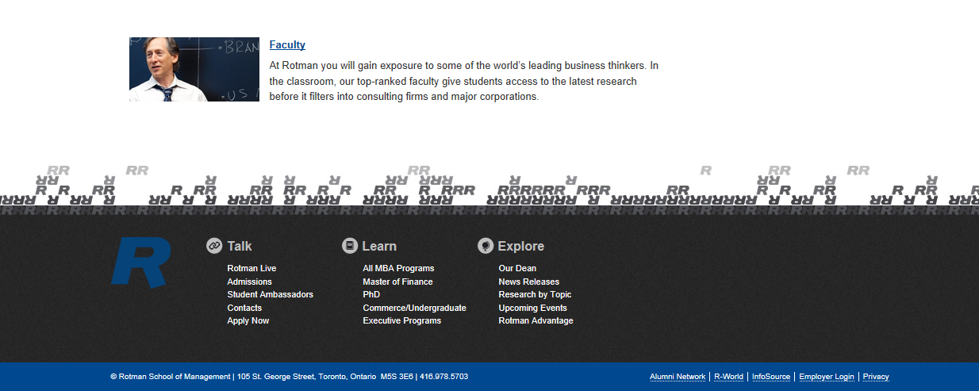
Common Page Fields
Title
Subtitle
Thumbnail Image
Background Image
Breadcrumb
Teaser Text
Content Area
Right Rail
Note: All these elements can be edited through either the page editor or content editor mode.

Slide 28
Landing Page
The landing page consists of a bit of teaser text, plus an automatically generated list of all the subpages below it.

Slide 29
Examples of a Landing Page
Examples:
http://cd-www.rotman.utoronto.ca/Degrees/MastersPrograms/MBAPrograms/FullTimeMBA/Academics.aspx
http://cm-www.rotman.utoronto.ca/Degrees/MastersPrograms/MBAPrograms.aspx

Slide 30
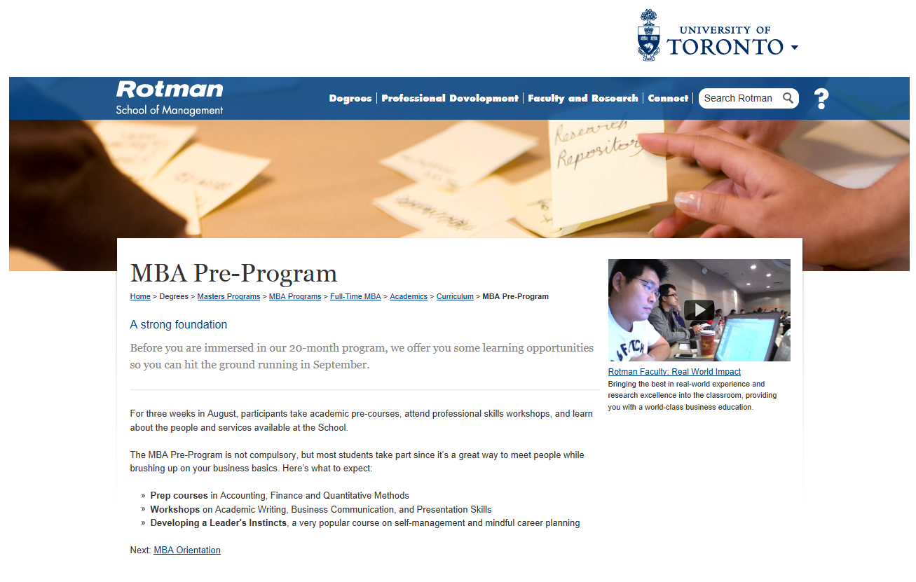
Generic Sub-Page
The Generic Sub-page is the simplest of all the pages, it contains teaser text, plus a rich text area enabling you to add a variety of content, including widgets.

Slide 31
Examples of a Generic Subpage
http://cd-www.rotman.utoronto.ca/Connect/DeanRogerMartin/MeetTheDean.aspx
This one has lots of elements:
http://cd-www.rotman.utoronto.ca/Degrees/MastersPrograms/MBAPrograms/FullTimeMBA/Careers/CareerCentre/CareerServices.aspx

Slide 32
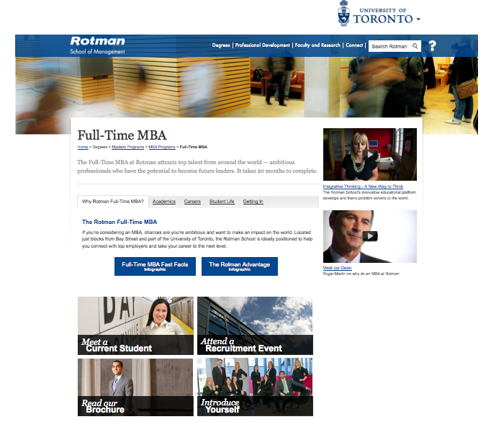
Program Landing Page
Combines various widgets – the Tab Box widget, as well a series of image text box widgets – to present a variety of information on one page.
We’ve used this as an overview or showcase page, to give a snap shot of our main programs.

Slide 33
Examples of a Program Landing Page
http://cd-www.rotman.utoronto.ca/Degrees/MastersPrograms/MBAPrograms/FullTimeMBA.aspx

Slide 34
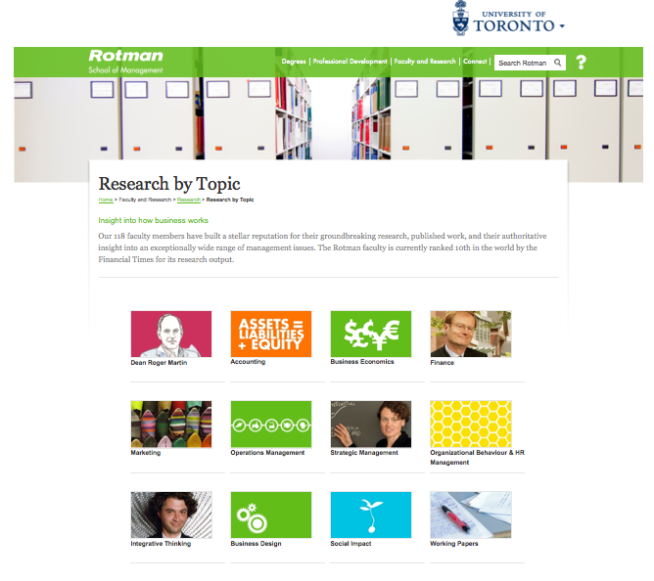
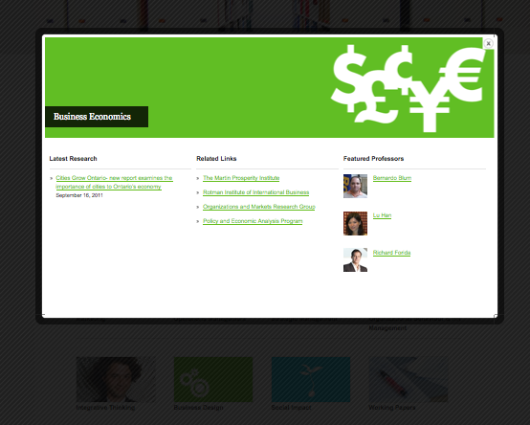
Topic Page
A gridded image layout. The images are links that present information in a lightbox.
Designed specifically for the Research by Topic page.
Note: Topic Grids cannot be used with a right rail.

Slide 35
Example of a Topic Page
http://cd-www.rotman.utoronto.ca/FacultyAndResearch/Research/ResearchByTopic.aspx

Slide 36
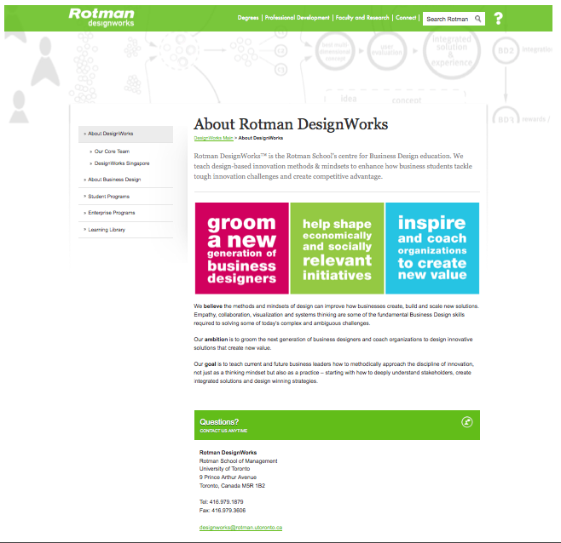
Institute Landing Page
Adds left hand navigation as well as a smaller banner to a Generic Subpage. These pages contain no right rail.
Designed as the homepage specically for our institutes.

Slide 37
Example of a Institute Landing Page
http://cd-www.rotman.utoronto.ca/FacultyAndResearch/EducationCentres/DesignWorks/About%20DesignWorks.aspx

Slide 38
Redirect Page
A simple page added to the navigation that redirects people landing on that page to another.

Slide 39
Demonstration Time!
Creating Pages
Identifying fields

Slide 40
Making Pages Fancy
But remember, a page type is really just a starting point
Widgets & Snippets – are bits of code we can add to our pages to increase functionality and Interactivity.

Slide 41
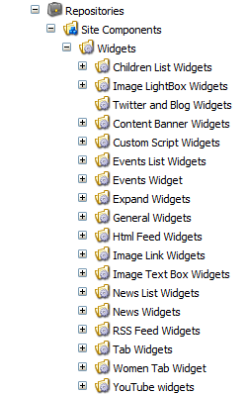
Widgets
You create a widget first in the repository and then insert it into your page in the page editor mode.
Widgets are created in the same way pages are – by right clicking on the corresponding folder of the widget you’d like to make.

Slide 42
Adding Widgets
From the page editor mode, click “Component” in the Home tab of the ribbon…

Slide 43
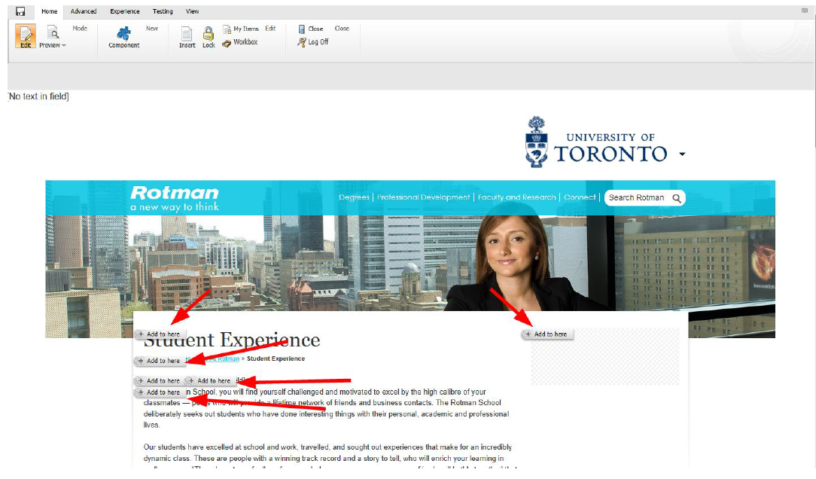
This will show you the various places on the page where widgets can be added

Slide 44
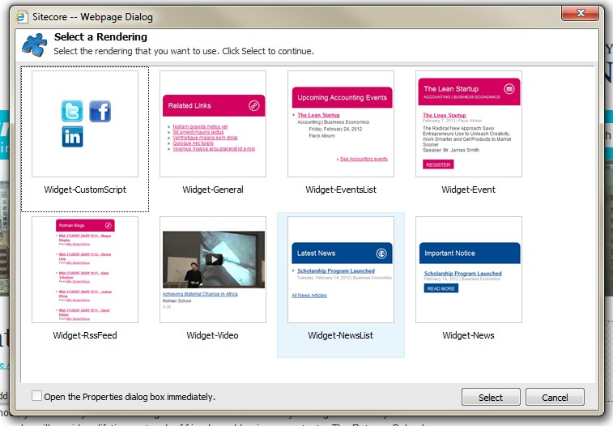
The widget menu will pop up (note: this feature does not work in all browsers; recommend IE8)

Slide 45
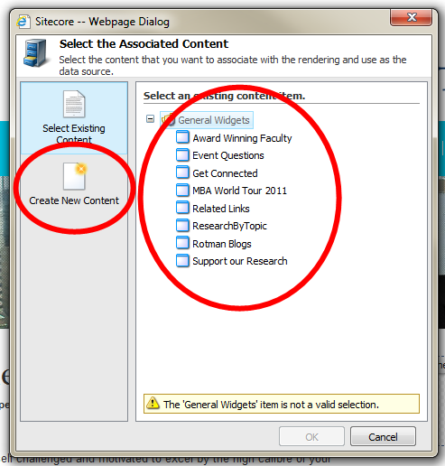
Widgets aren’t separate from the content they display so you have to either select an existing content item or create a new one .

Slide 46
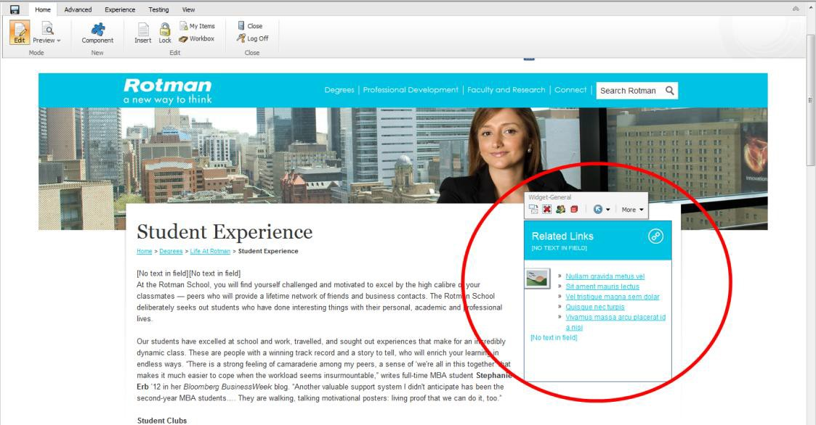
In this example, we selected “Related Links”
IMPORTANT NOTE: If the same piece of Associated Content is used in two places, editing one will affect the other. If you want to reuse associated content, create multiple versions (eg: StudentExperience Related Links)
ANOTHER IMPORTANT NOTE: Widget placement isn’t saved until you save the page

Slide 47
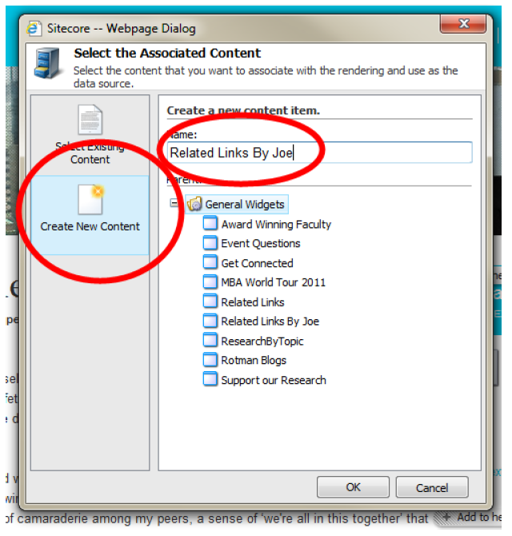
You can also create new content for the widget

Slide 48
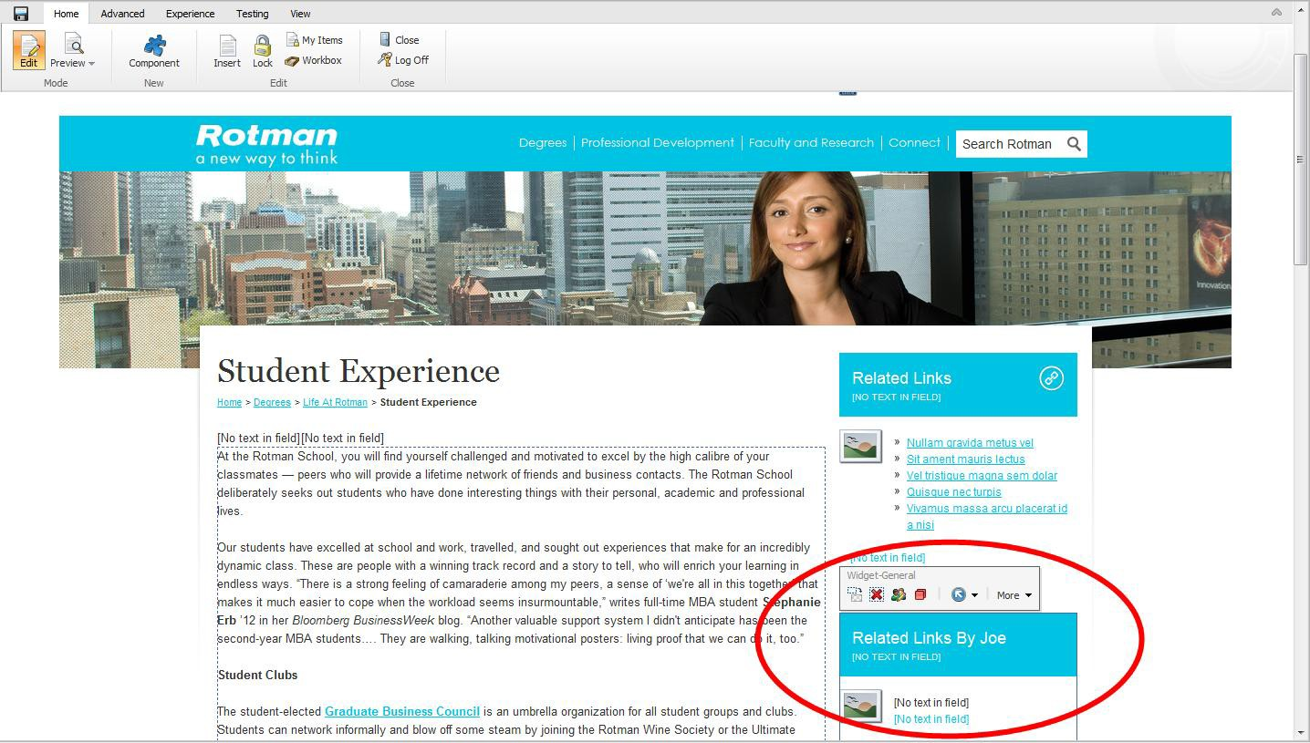
Enter the content directly into Page Editor mode. When you save the page, the Associated Content item will also be saved

Slide 49
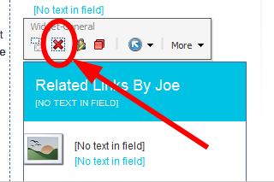
Removing Widgets
To remove a widget, simply click the red X
IMPORTANT NOTE: It doesn’t ask you if you’re sure. If you accidentally delete a widget and you haven’t made any other changes to the page since your last save, just close the browser window without saving
Now, let’s go over the different types…

Slide 50
Children List Widgets
Used to mimic the subpage list found on a landing page.
Can be added to any Generic Subpage to create a menu of subpages.

Slide 51
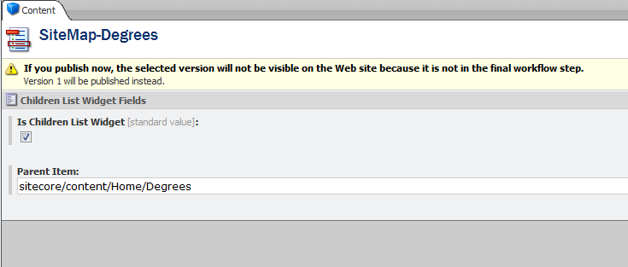
How to Create a Children List Widgets
Simply choose the Parent Item or Landing page of the area you would like to mimic, sitecore pulls a list of all the subpages below.

Slide 52
Image Lightbox Widget
An image launches a larger image in a lightbox.
This image links to…
This larger image.

Slide 53
How to Create an Image Lightbox Widget
Upload both images to the media library
Add the image in the Thumbnail image field
Add the larger Image in the Full-size field

Slide 54
Examples
http://cd-www.rotman.utoronto.ca/Connect/RotmanAdvantage.aspx
http://cd-www.rotman.utoronto.ca/Connect/RotmanAdvantage/Room%20to%20Grow.aspx

Slide 55
Content Banner Widgets
Used exclusively on the Institute Page
Adds an image banner that fits next to the Institute left-hand navigation

Slide 56
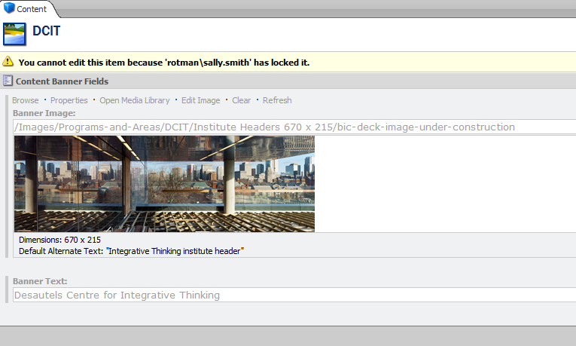
How to Create Content Banner Widgets
Upload the image to the media library
Add the image in the Banner image field
Fill in the Banner Text

Slide 57
Examples
http://cd-www.rotman.utoronto.ca/FacultyAndResearch/ResearchCentres/CapitalMarketsInstitute.aspx
http://cd-www.rotman.utoronto.ca/FacultyAndResearch/ResearchCentres/InstituteForInternationalBusiness.aspx

Slide 58
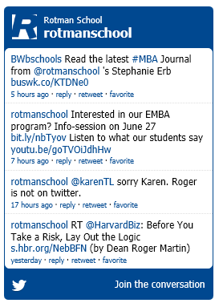
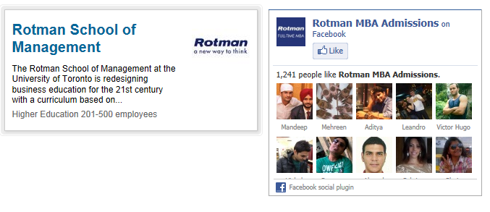
Custom Script Widgets
Allows you to add profiles and feeds from 3rd party sites like Twitter, LinkedIn, Flickr etc.

Slide 59
How to add Custom Script Widgets
Insert code provided by 3rd party – each one is slightly different.

Slide 60
Examples
http://cd-www.rotman.utoronto.ca/Connect/RotmanLive.aspx

Slide 61
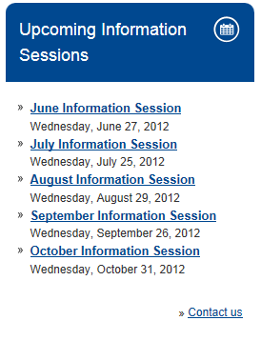
Events List Widget
Adds a list of events generated from the events listing in Sitecore

Slide 62
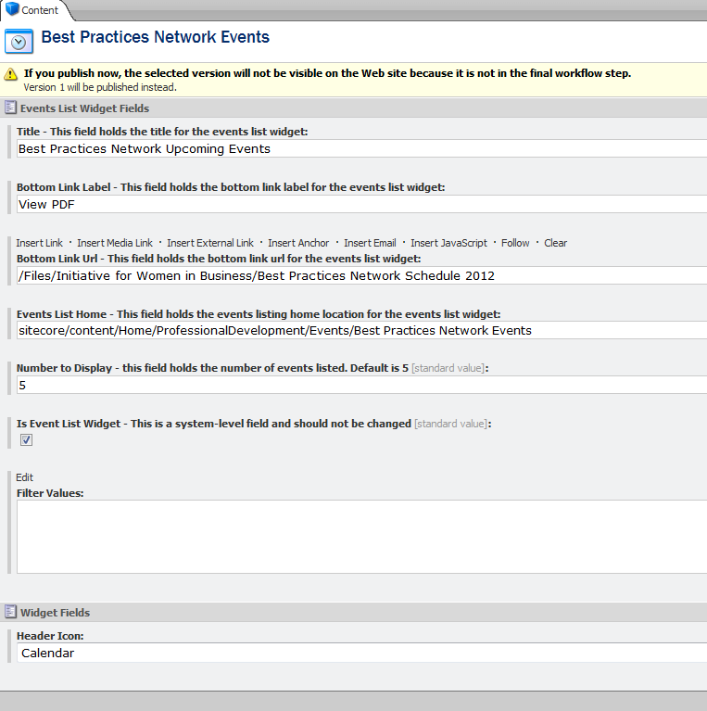
How to Add an Events List Widget
Fill in the Title
Add the label for the bottom link
Choose where you would like that link to go
Choose the Events listing from the events area
Choose an icon

Slide 63
Examples
http://cd-www.rotman.utoronto.ca/Degrees/MastersPrograms/MBAPrograms/OmniumGlobalEMBA.aspx

Slide 64
Events Widget
Gives you the ability to profile an upcoming event.
Note: Not widely used yet – you could be the first!

Slide 65
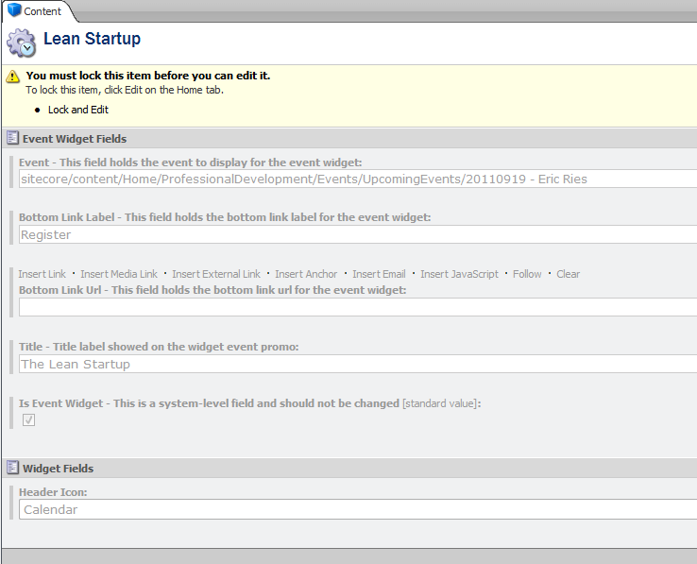
How to Add an Events Widget
Choose the event from the drop down menu
Add the label for the bottom link
Choose where you would like that link to go
Add the title
Choose an icon

Slide 66
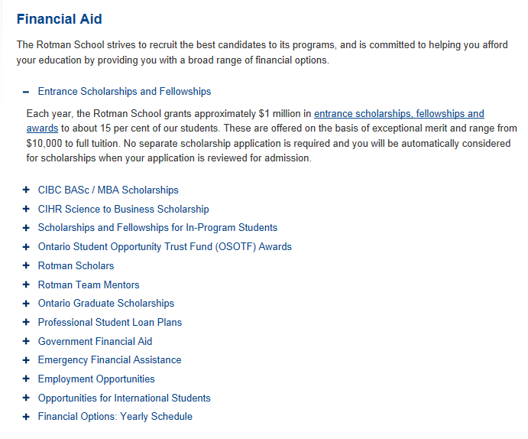
Expand Widgets
Adds expanding and collapsing functionality, allows you to hide text underneath
Great for minimizing large amounts of text.

Slide 67
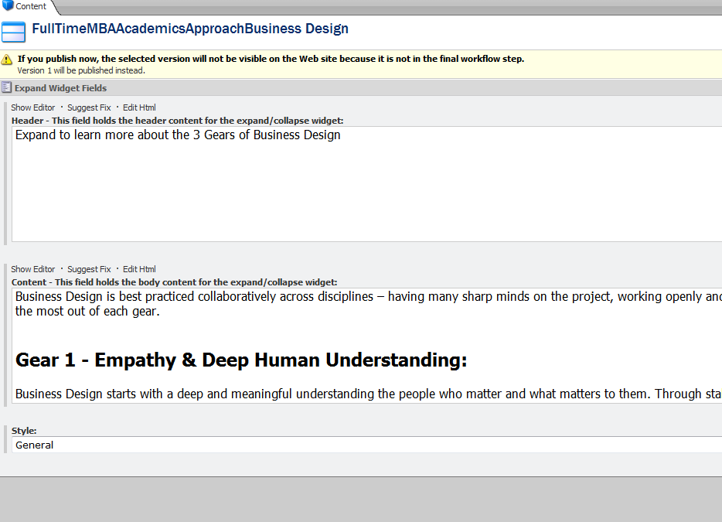
Adding Expand Widgets
Add the header – the title of the expand widget. This will be the information that’s always seen
Add the content in the content field – can be an image or just plain text.
Choose the style – there are three to choose from.

Slide 68
Example of Expand Widgets
http://cd-www.rotman.utoronto.ca/Degrees/YourDegree/ApplyNow.aspx

Slide 69
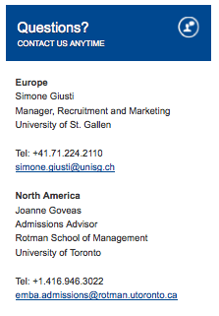
General Widget
Give you a fancy customizable header with a rich text area underneath.
Great for adding contact information or a list of related links

Slide 70
Examples
They’re literally everywhere!

Slide 71
Image Link Widget
Simply an image in the right rail that is a link to wherever you’d like.

Slide 72
Example of a Image Link Widget
http://cd-www.rotman.utoronto.ca/Connect/RotmanAdvantage/Toronto.aspx

Slide 73
Image Textbox widget
Contained in the main content area, the image textbox widget has a rollover to display more content, plus a link to another area.

Slide 74
Examples of an Image Textbox Widget
http://cd-www.rotman.utoronto.ca/Degrees/MastersPrograms/MBAPrograms/PartTimeMBA/MorningMBA.aspx
http://cd-www.rotman.utoronto.ca/Degrees/MastersPrograms/MBAPrograms/FullTimeMBA/StudentLife/LifeatRotman/Day-in-the-Life.aspx

Slide 75
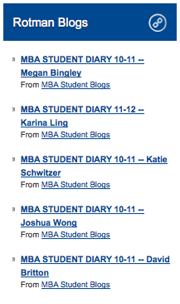
RSS Feed
Pulls in a feed and lists it in the right rail

Slide 76
Example of an RSS Feed Widget
http://cd-www.rotman.utoronto.ca/Degrees/MastersPrograms/MBAPrograms/FullTimeMBA/StudentLife/LifeatRotman/Day-in-the-Life.aspx

Slide 77
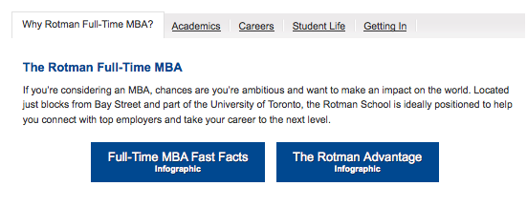
Tab Widget
Creates the tabbed structure seen in the program landing page

Slide 78
Examples of a Tab Widget
http://cd-www.rotman.utoronto.ca/Degrees/MastersPrograms/MBAPrograms/FullTimeMBA.aspx

Slide 79
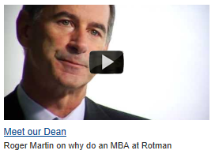
Youtube Widget
Pulls a video from YouTube and plays it in a lightbox on our site.

Slide 80
Examples of a YouTube Widget
http://cd-www.rotman.utoronto.ca/Degrees/MastersPrograms/MBAPrograms/FullTimeMBA.aspx

Slide 81
Demonstration Time!
Exploring the widget repository
Showing the widget areas in Page Editor mode
Adding a widget with existing Associated Content
Adding a widget and creating Associated Content
Removing a widget

Slide 82
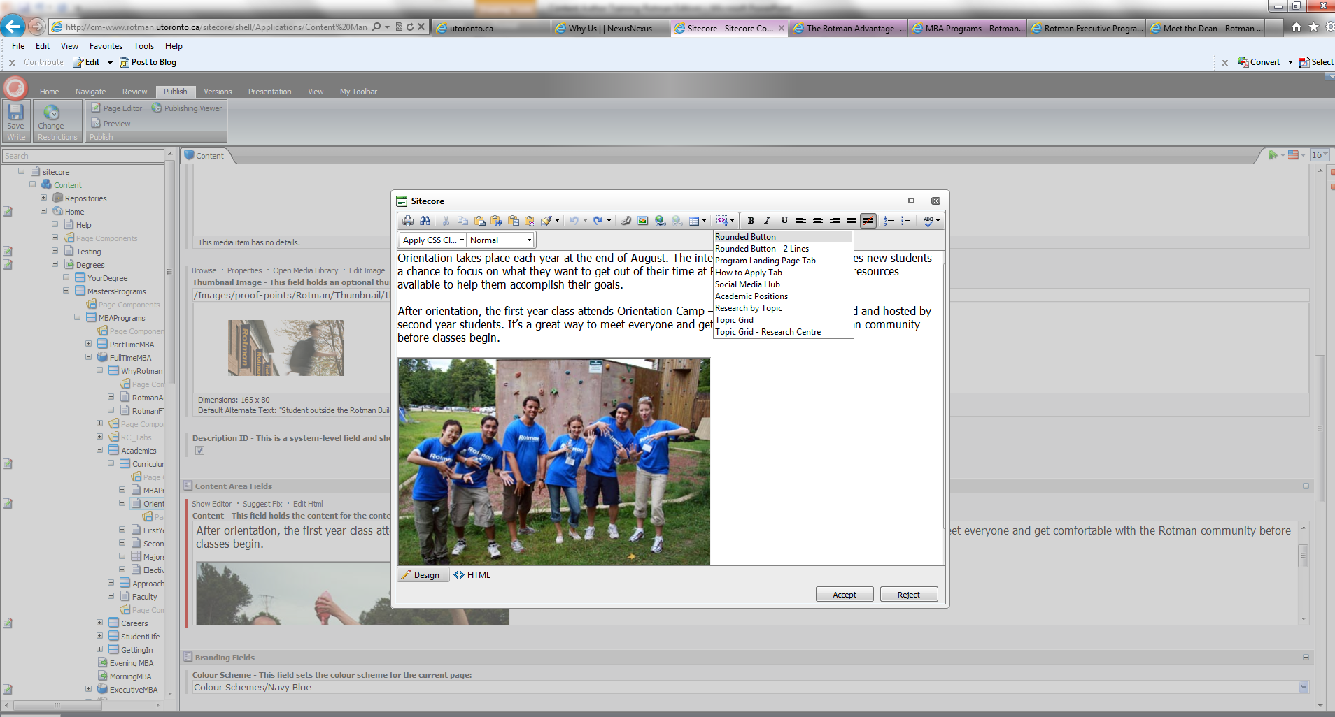
Snippets
Snippets are added through the Content Editor mode.

Slide 83
Types of Snippets
Rounded button
Rounded button – 2 lines
How to Apply tab
Social Media Hub
Academic Positions
Research by Topic
Topic Grid
Topic Grid – Research Centre
Note: some of these snippets were designed for a very specific purpose. We’ll only go over the usefull ones underlined.

Slide 84
Rounded Button & Rounded Button – 2 lines
One line or two – Has some text, plus a link
Customizable in Content Editor & page Editor mode

Slide 85
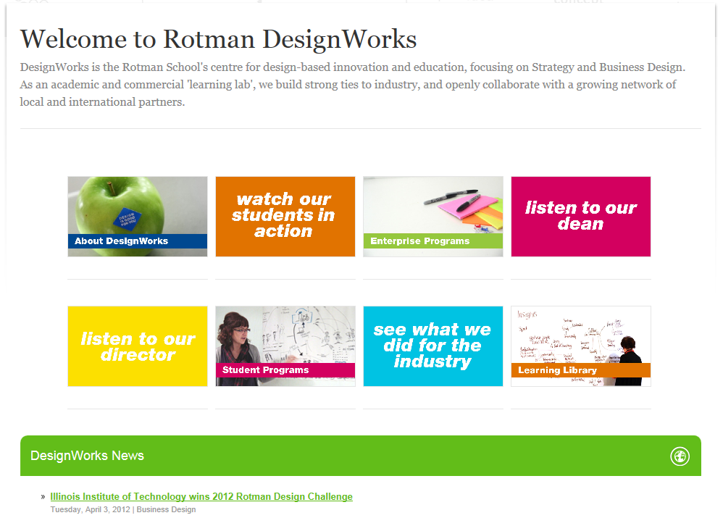
Topic Grid
Mimics the layout of the Topic page, without the functionality of the lightbox – each image is a link.
Note: Topic Grids cannot be used with a right rail.

Slide 86
Demonstration Time!
Adding a Snippet
Editing a Snippet

Slide 87
Governance
In this context, governance speaks to various user roles and workflows

Slide 88
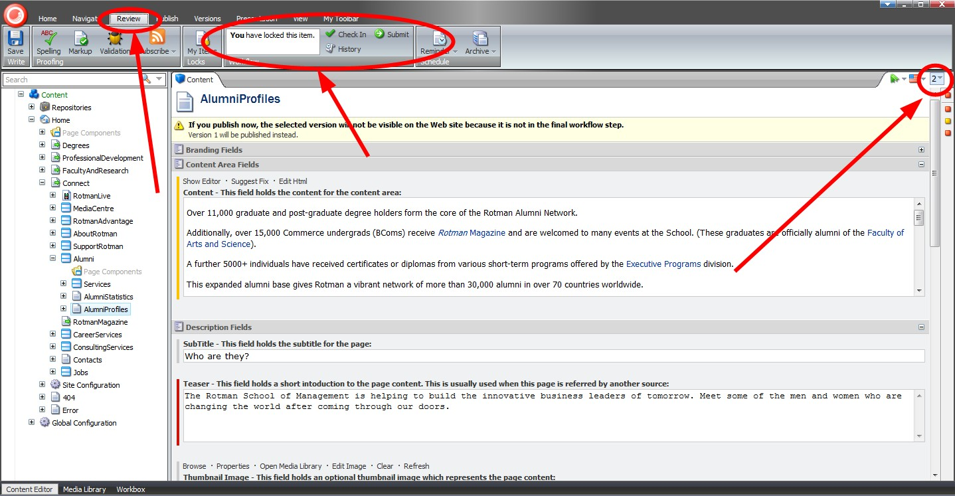
When viewing an item in Content Editor mode, you can click “Review” in the ribbon to see the item’s status. If you’ve locked the item you can check it in to discard your lock or you can click “Submit” to move it along the workflow. The current version number is in the top right corner; you can click it to see the version history.

Slide 89
Click “Workbox” at the bottom of the screen to launch the workbox mode. Scroll down in the “workflows” menu and select “Content Workflow”

